Slide 1
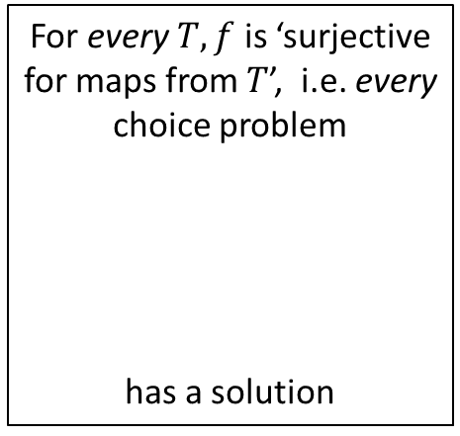









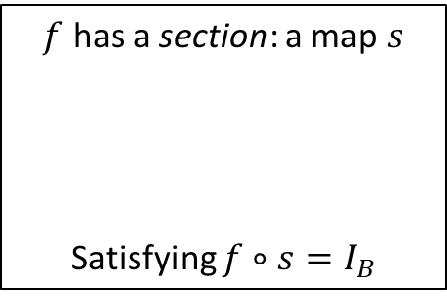
















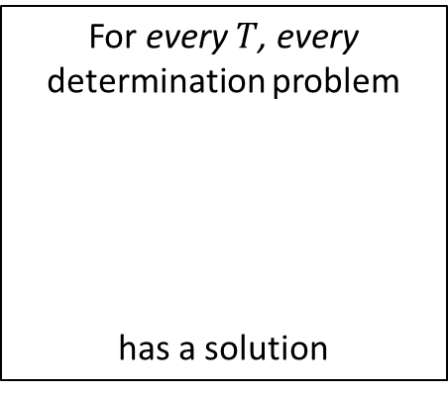









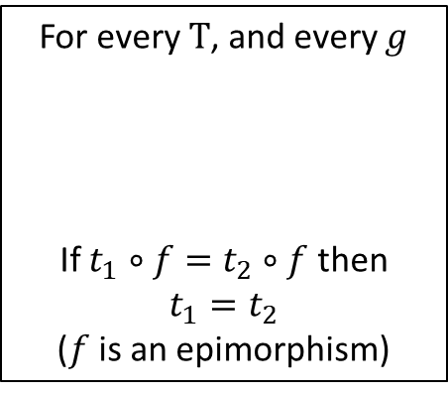
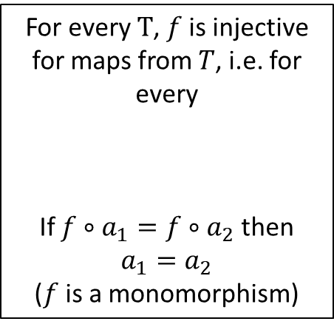







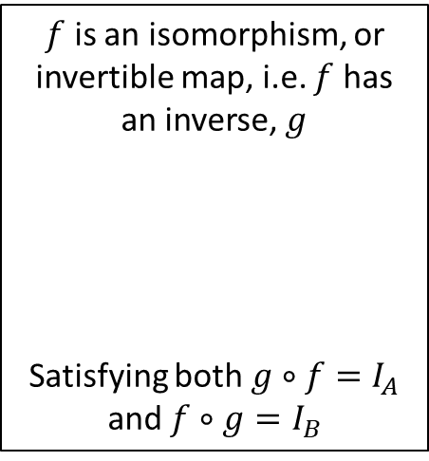

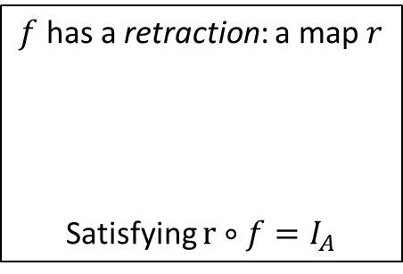


$f$ has a section: a map $s$
Satisfying $f∘s=I_{B}$
For every $T$, and every $g$
If $t_{1}∘f=t_{2}∘f$ then $t_{1}=t_{2}$
($f$ is an epimorphism)
$$s$$
$f$ has a retraction: a map $r$
Satisfying $r∘f=I_{A}$
$$t_{1}$$
$$r$$
$$B$$
$$T$$
$$A$$
$$B$$
$$t_{2}$$
$$f$$
$$A$$
$$B$$
$f$ is an isomorphism, or invertible map, i.e. $f$ has an inverse, $g$
Satisfying both $g∘f=I_{A}$ and $f∘g=I_{B}$
$$f$$
or
The choice problem
has a solution
or
$$g$$
$$A$$
The determination problem
has a solution
$$f$$
$$B$$
$$s?$$
$$r?$$
$$f$$
$$A$$
$$B$$
$$B$$
$$B$$
$$f$$
$$I_{B}$$
$$A$$
$$A$$
For every $T$, $f$ is injective for maps from $T$, i.e. for every
If $f∘a_{1}=f∘a_{2}$ then $a_{1}=a_{2}$
($f$ is a monomorphism)
$$I_{A}$$
or
For every $T, f$ is ‘surjective for maps from $T$’, i.e. every choice problem
has a solution
or
$$a_{1}$$
For every $T$, every determination problem
has a solution
$$T$$
$$A$$
$$B$$
$$a_{2}$$
$$A$$
$$?$$
$$f$$
$$f$$
$$?$$
$$A$$
$$T$$
$$T$$
$$B$$
$$t$$
$$b$$

Slide 2









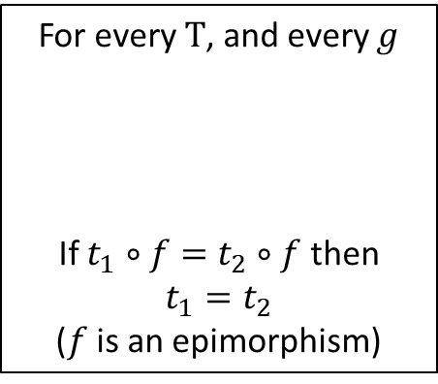
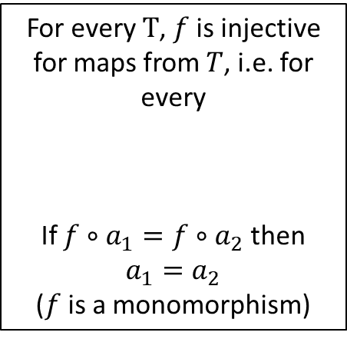



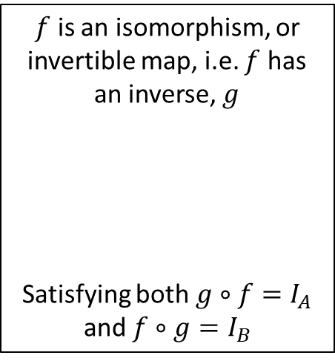











Determination problem
$$B$$
$f$ has a section: a map $s$
Satisfying $f∘s=I_{B}$
For every $T$, and every $g$
If $t_{1}∘f=t_{2}∘f$ then $t_{1}=t_{2}$
($f$ is an epimorphism)
$$B$$
$f$ has a retraction: a map $r$
Satisfying $r∘f=I_{A}$
$$f$$
$$g?$$
$$s$$
$$t_{1}$$
$$f$$
$$r$$
$$B$$
$$T$$
$$A$$
$$B$$
$$t_{2}$$
$$A$$
$$C$$
$$A$$
$$C$$
$$f$$
$$A$$
$$B$$
$$h$$
$$h$$
$$f$$
Choice problem
or
$$B$$
$$B$$
The choice problem
has a solution
or
$$g$$
$$g$$
$$A$$
The determination problem
has a solution
$$f?$$
$$f$$
$$B$$
$$s?$$
$$r?$$
$$A$$
$$C$$
$$A$$
$$C$$
$$f$$
$$h$$
$$h$$
$$B$$
$$B$$
$$I_{B}$$
$$A$$
$$A$$
For every $T$, $f$ is injective for maps from $T$, i.e. for every
If $f∘a_{1}=f∘a_{2}$ then $a_{1}=a_{2}$
($f$ is a monomorphism)
$$I_{A}$$
$f$ is an isomorphism, or invertible map, i.e. $f$ has an inverse, $g$
Satisfying both $g∘f=I_{A}$ and $f∘g=I_{B}$
or
For every $T, f$ is ‘surjective for maps from $T$’, i.e. every choice problem
has a solution
or
$$a_{1}$$
For every $T$, every determination problem
has a solution
$$T$$
$$A$$
$$B$$
$$a_{2}$$
$$A$$
$$?$$
$$f$$
$$f$$
$$?$$
$$f$$
$$A$$
$$T$$
$$T$$
$$B$$
$$t$$
$$b$$

Slide 3
Determination

Slide 4

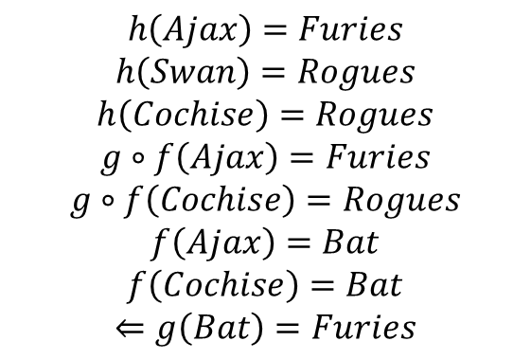




$$h\left(Ajax\right)=Furies$$
$$h\left(Swan\right)=Rogues$$
$$h\left(Cochise\right)=Rogues$$
$$g∘f\left(Ajax\right)=Furies$$
$$g∘f\left(Cochise\right)=Rogues$$
$$f\left(Ajax\right)=Bat$$
$$f\left(Cochise\right)=Bat$$
$$⇐g\left(Bat\right)=Furies$$
$B$ – Weapons
Bat
Knife
Pipe
$$f$$
Furies
Ajax
Cochise
Swan
Rogues
$$h$$
$A$ - characters
$C$ - gangs

Slide 5

$$h\left(Ajax\right)=Furies$$
$$h\left(Swan\right)=Rogues$$
$$h\left(Cochise\right)=Rogues$$
$$g∘f\left(Ajax\right)=Furies$$
$$g∘f\left(Cochise\right)=Rogues$$
$$f\left(Ajax\right)=Bat$$
$$f\left(Cochise\right)=Bat$$
$$⇐g\left(Bat\right)=Furies$$
$B$ – Weapons
Bat
Knife
Pipe
$$f$$
$$g$$
Furies
Ajax
Cochise
Swan
Rogues
$$h$$
$A$ - characters
$C$ - gangs

Slide 6

$$h\left(Ajax\right)=Furies$$
$$h\left(Swan\right)=Rogues$$
$$h\left(Cochise\right)=Rogues$$
$$g∘f\left(Ajax\right)=Furies$$
$$g∘f\left(Cochise\right)=Rogues$$
$$f\left(Ajax\right)=Bat$$
$$f\left(Cochise\right)=Bat$$
$$⇐g\left(Bat\right)=Furies$$
$B$ – Weapons
Bat
Knife
Pipe
$$f$$
$$g?$$
Furies
Ajax
Swan
Cochise
Rogues
$$h$$
$A$ - characters
$C$ - gangs

Slide 7











Determination problem
$$B$$
$$B$$
$$f$$
$$f$$
$$g?$$
$$A$$
$$C$$
$$A$$
$$C$$
$$h$$
$$h$$

Slide 8
Choice

Slide 9




Warriors
Cyrus
Rogues
Swan
Furies
$$f$$
Sully
Cobb
Cropsey
Convenience
Store Girl
Orphans
Cleon
Gramercy Riffs
Luther
Masai
Purple Face
$A$ - gangs
$A$ - characters
Vests
Gun
Leather
Knife
Bat
Baseball
Uniform
Karate Gi
Pipe
T-shirts
Chain
$C$ – uniforms/colors
Ajax, Cleon, Cochise, Cowboy, Fox, Rembrandt, Snow, Swan and Vermin.

Slide 11



Warriors
The Warriors Gangs - The Warriors Movie Site
Rogues
Furies
Orphans
Gramercy Riffs
$B$ - gangs
Cyrus
Vests
Swan
Leather
Gun
Sully
Cobb
Cropsey
Karate Gi
Knife
Cleon
Baseball
Uniform
Bat
Luther
Pipe
Masai
T-shirts
Purple Face
Chain
$A$ - characters
$C$ – uniforms/colors

Slide 12



Warriors
Cyrus
Rogues
Swan
Furies
$$f$$
Sully
Cobb
Cropsey
Convenience
Store Girl
Orphans
Cleon
Gramercy Riffs
Luther
Masai
Purple Face
$A$ - gangs
$$h$$
$B$ - characters
$$g$$
Vests
Leather
Baseball
Uniform
Karate Gi
T-shirts
$C$ – uniforms/colors

Slide 13

The Warriors Gangs - The Warriors Movie Site
Warriors
Cyrus
Rogues
Swan
Furies
Sully
Cobb
Cropsey
Orphans
Cleon
Gramercy Riffs
Luther
Masai
Purple Face
$A$ - gangs
$B$ - characters
Vests
Gun
Leather
Knife
Bat
Baseball
Uniform
Karate Gi
Pipe
T-shirts
Chain
$C$ – uniforms/colors

